Slide 1
INTERNITY FOUNDATION
PRESENTATION ON DIVIDE AND CONQUER ,BINARY SEARCH AND AVL TREES
Presented by:
Lipika Chugh
Aman Goyal
Akash Sharma

Slide 2
DIVIDE & CONQUER
The most well known algorithm design strategy:
Divide the problem into two or more smaller subproblems.
Conquer the subproblems by solving them recursively.
Combine the solutions to the subproblems into the solutions for the original problem.
2

Slide 3
DIVIDE & CONQUER ALGORITHMS
1

Slide 4
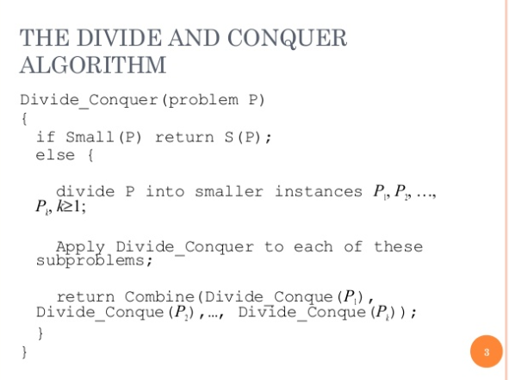
3

Slide 5
DIVIDE AND CONQUER EXAMPLES
′ Merge sort
′ Quick sort
′ Binary Search
4

Slide 6
MERGE SORT
′ The merge sort algorithm works from “the bottom up”
start by solving the smallest pieces of the main problem
keep combining their results into larger solutions
eventually the original problem will be solved
5

Slide 7
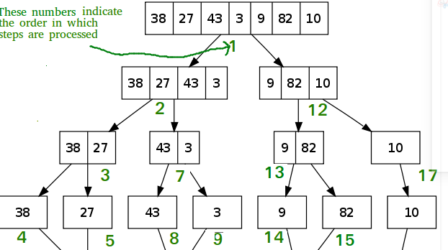
′
6

Slide 8
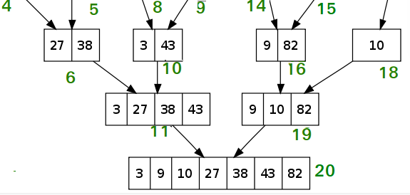

Slide 9
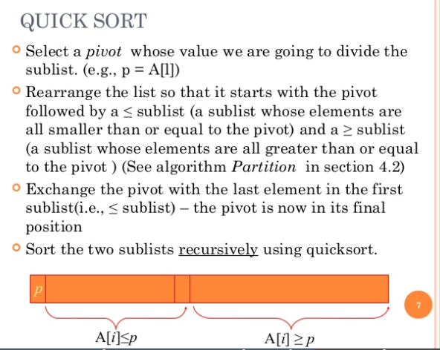
′
7

Slide 10
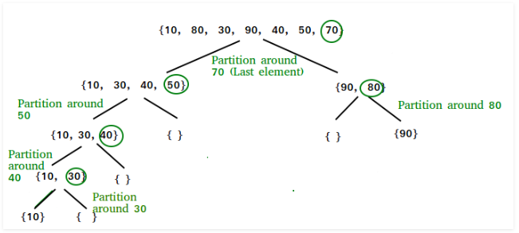
8

Slide 11
Binary Search

Slide 12
This is a searching algorithm ,which uses divide and conquer approach.
It is also referred to as half interval search,logarithmic search and binary chop.
It uses a sorted list to search a given element from an array of elements.
The binary search algorithm uses worst case time complexity of O(logn) and space complexity of O(1)for finding a particular element in the array.
In order to search an element from a 2.5 M elements array,it would at most take 22 comparisons,so it is very fast.
T(n) = T(n/2) + c is the time equation for binary search.

Slide 13
Algorithm
int binarySearch(int low,int high,int key)
{
while(low<=high)
{
int mid=(low+high)/2;
if(a[mid]<key)
{
low=mid+1;
}
else if(a[mid]>key)
{
high=mid-1;
}
else
{
return mid;
}
}
return -1; //key not found
}

Slide 14
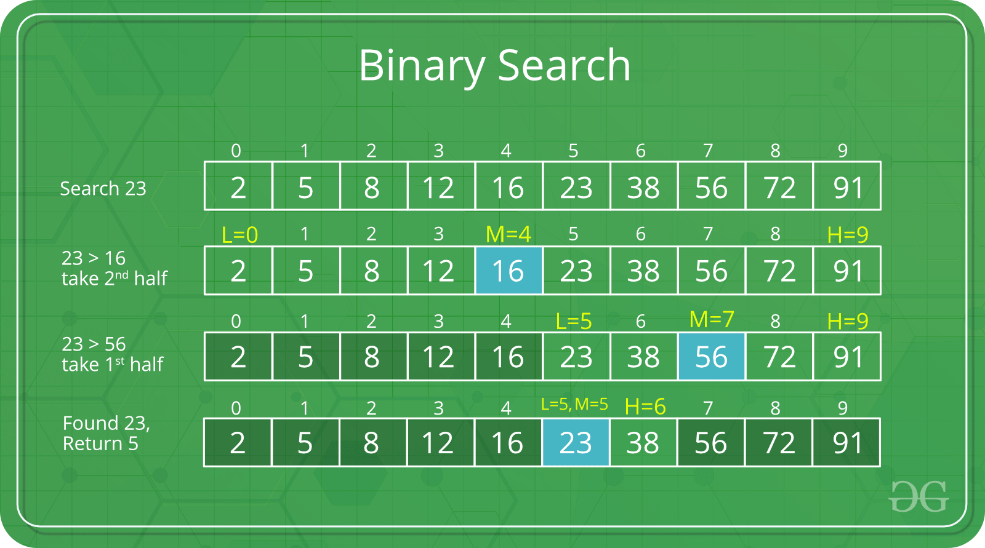

Slide 15
Randomized binary search
int randomizedBinarySearch(int arr[], int l,
int r, int x)
{
while (l <= r)
{
// Here we have defined middle as
// random index between l and r ie.. [l, r]
int m = getRandom(l, r);
// Check if x is present at mid
if (arr[m] == x)
return m;
// If x greater, ignore left half
if (arr[m] < x)
l = m + 1;
// If x is smaller, ignore right half
else
r = m - 1;
}
// if we reach here, then element was
// not present
return -1;
}
int getRandom(int x, int y)
{
srand(time(NULL));
return (x + rand()%(y-x+1));
}
Randomized binary search makes sense if your randomness source has a good bias towards your search target. You can then use it to reduce the expected search time (even retaining the
O(logn)
O(log⁡n) asymptotic worst-case complexity

Slide 16
Square root using binary search upto given precision
float squareRoot(int number, int precision)
{
int start = 0, end = number;
int mid;
float ans;
while (start <= end) {
mid = (start + end) / 2;
if (mid * mid == number) {
ans = mid;
break;
}
if (mid * mid < number) {
start = mid + 1;
}
else {
end = mid - 1;
}
}
float increment = 0.1;
for (int i = 0; i < precision; i++) {
while (ans * ans <= number) {
ans += increment;
}
// loop terminates when ans * ans > number
ans = ans - increment;
increment = increment / 10;
}
return ans;
}
Input : number = 50, precision = 3
Output : 7.071
Input : number = 10, precision = 4
Output : 3.1622

Slide 17
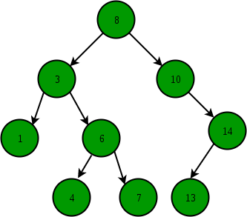
Binary Search Tree
It is a data structure which is used to store elements in sorted order,and can be efficiently used to search ,insert or delete elements.
In this the left subtree values are less than the given node and right subtree value is greater.
In this the left subtree and the right trees are also a binary search tree.
In best and average case its time complexity is O(logn)
However in worst case the time complexity goes upto O(n),in case where elements are already in increasing order or decreasing order or even when all elements are same.

Slide 18
Search an element
Insert an element
struct node* search(int data){
struct node *current = root;
printf("Visiting elements: ");
while(current->data != data){
if(current != NULL) {
printf("%d ",current->data);
//go to left tree
if(current->data > data){
current = current->leftChild;
} //else go to right tree
else {
current = current->rightChild;
}
if(current == NULL){
return NULL;
}
}
}
return current;
}
tempNode->data = data;
tempNode->leftChild = NULL;
tempNode->rightChild = NULL;
if(root == NULL) {
root = tempNode;
} else {
current = root;
parent = NULL;
while(1) {
parent = current;
if(data < parent->data) {
current = current->leftChild;
if(current == NULL) {
parent->leftChild = tempNode;
return;
}
}
else {
current = current->rightChild;
if(current == NULL) {
parent->rightChild = tempNode;
return;
}

Slide 19
AVL Trees

Slide 20
Why AVL Trees?
Most of the BST operations (e.g., search, max, min, insert, delete.. etc) take O(h) time where h is the height of the BST. The cost of these operations may become O(n) for a skewed Binary tree. If we make sure that height of the tree remains O(Logn) after every insertion and deletion, then we can guarantee an upper bound of O(Logn) for all these operations. The height of an AVL tree is always O(Logn) where n is the number of nodes in the tree

Slide 21
Balanced Binary Search Trees
•If the height of a binary tree is always O(log n), we can guarantee O(log n) performance for each search tree operation
•Trees with a worst-case height of O(log n) are called balanced trees
•An example of a balanced tree is AVL (Adelson-Velsky and Landis) tree

Slide 22
Definition
•Binary tree.
•If T is a nonempty binary tree with T_{L} and T_{R} as its left and right subtrees, then T is an AVL tree iff
1.T_{L} and T_{R} are AVL trees, and
2.|h_{L} – h_{R}| £ 1 where h_{L} and h_{R} are the heights of T_{L} and T_{R}, respectively

Slide 23
Properties of AVL Tree
1.The height of an AVL tree with n nodes is O(log n)
2.For every value of n, n >= 0, there exists an AVL tree
3.An n-node AVL search tree can be searched in O(height) = O(log n) time
4.A new node can be inserted into an n-node AVL search tree so that the result is an n+1 node AVL tree and insertion can be done in O(log n) time
5.A node can be deleted from an n-node AVL search tree, n>0, so that the result is an n-1 node AVL tree and deletion can be done in O(log n) time

Slide 24
Balance Factor
•AVL trees are normally represented using the linked representation
•To facilitate insertion and deletion, a balance factor (bf) is associated with each node
•The balance factor bf(x) of a node x is defined as
height(x->leftChild) – height(x->rightChild)
•Balance factor of each node in an AVL tree must be
–1, 0, or 1

Slide 25
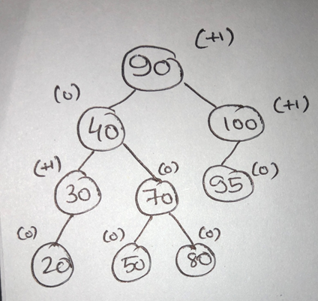
AVL Tree Definition
•An empty binary tree is an AVL search tree.
•A non-empty BST is an AVL search tree iff, the balance factors of every node in the tree is either 0, 1 or -1.

Slide 26
Insertion in AVL Tree
•Insertion of a key into an AVL tree proceeds in the same way as that of a BST.
•However, if while inserting a key, the BF of any node falls out of the permissible limit (i.e. 0, 1 or -1), then we need to apply rotations to make the tree height-balanced.

Slide 27
What are the different types of rotation?
•LL: The inserted node X is in the left sub-tree of the left sub-tree of the node A.
•RR: The inserted node X is in the right sub-tree of the right sub-tree of the node A.
•LR: The inserted node X is in the right sub-tree of the left sub-tree of the node A.
•RL: The inserted node X is in the left sub-tree of the right sub-tree of the node A.

Slide 28
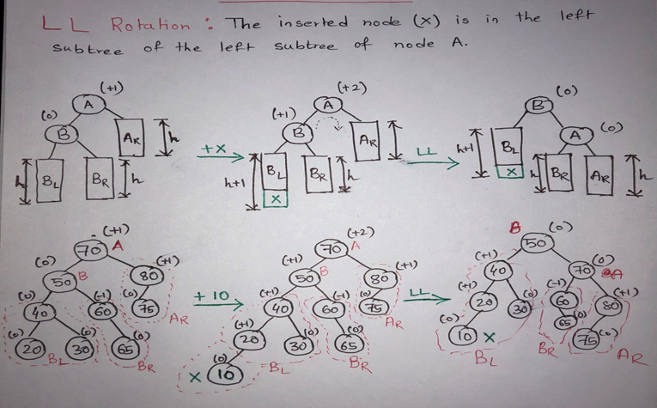
LL Rotation

Slide 29
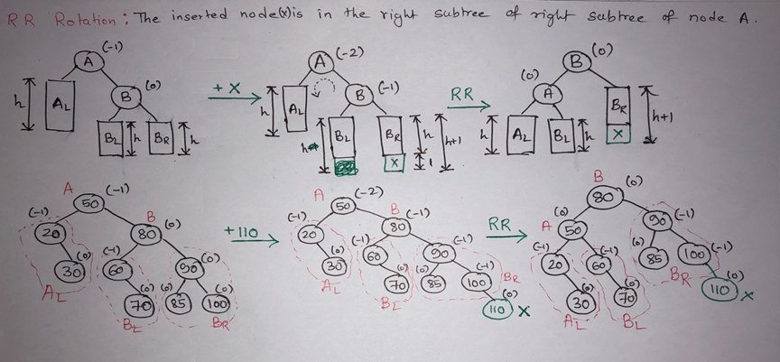
RR Rotation

Slide 30
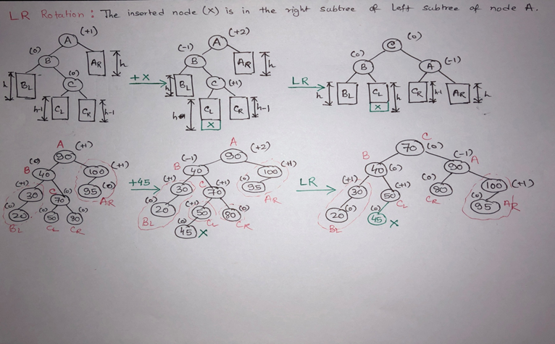
LR Rotation

Slide 31
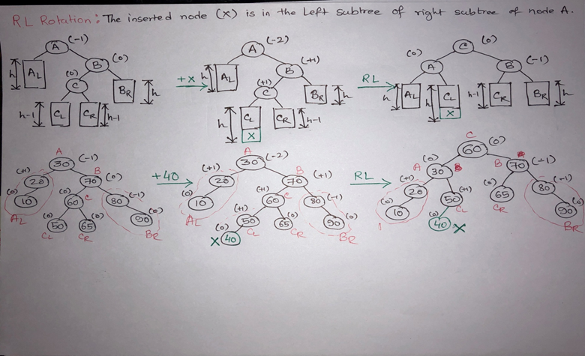
RL Rotation

Slide 32
Analysis
Single rotation preserves the original height:
–The new height of the entire subtree is exactly the same as the height of the original subtree before the insertion.
•Therefore it is enough to do rotation only at the first node, where imbalance exists, on the path from inserted node to root.
•Thus the rotation takes O(1) time.
•Hence insertion is O(logN)

Slide 33
Deletion of a Node
•Deletion of a node x from an AVL tree requires the same basic ideas, including single and double rotations, that are used for insertion.
•With each node of the AVL tree is associated a balance factor that is left high, equal or right high according, respectively, as the left subtree has height greater than, equal to, or less than that of the right subtree.

